Slide 1
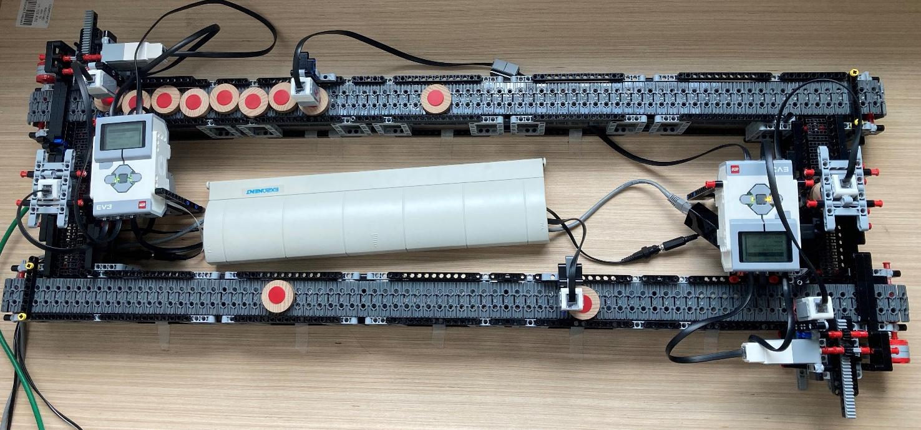
1
2

Slide 2
Evaluator starts
Physical system starts
Controller starts
Validation starts
Degradation of m2
Input idx. Not valid
Input Idx valid
Detect performance degradation
Best scenario implemented
L
I
S
L
I
S
L
I
S
L
I
S
L
I
S
L
I
S
L
I
S
L
I
S
0 ‘
10 ‘
20 ‘
26 ‘
35 ‘
40 ‘
41 ‘
43‘
Real time
0
1
2
3
4
5
6
7
Generation & Conversion
Update stochastic parameters
Update stochastic parameters
Synchronise instant conditions
Monitoring
Performance prediction
Performance prediction
What-if Analysis

Slide 3
= Not valid
L
= Logic
= Not checked
S
= Stoch. parameters
= Valid
I
= Instant conditions
EVENTS
Evaluator starts
Physical system starts
Controller starts
Validation starts
Degradation of m2
Input idx. Not valid
Input Idx valid
Detect performance degradation
Best scenario implemented
MARKERS
L
S
I
L
S
I
L
S
I
L
S
I
L
S
I
L
S
I
L
S
I
L
S
I
TIME-LINE
0 ‘
10 ‘
20 ‘
26 ‘
35 ‘
40 ‘
41 ‘
43‘
Real time
0
1
2
3
4
5
6
7
ALIGNMENT ACTIONS
Generation & Conversion
Update stochastic parameters
Update stochastic parameters
Synchronise instant conditions
DT SERVICES
MONITORING
PERFORMANCE PREDICTION
PERFORMANCE PREDICTION
WHAT-IF
ANALYSES

Slide 4
L
= Logic
EVENTS
S
= Stoch. parameters
Evaluator starts
I
= Instant conditions
Physical system starts
Controller starts
Validation starts
Degradation of m2
Input idx. Not valid
Input Idx valid
Detect performance degradation
Best scenario implemented
MARKERS
L
S
I
L
S
I
L
S
I
L
S
I
L
S
I
L
S
I
L
S
I
L
S
I
TIME-LINE
0 ‘
10 ‘
20 ‘
26 ‘
35 ‘
40 ‘
41 ‘
43‘
Real time
0
1
2
3
4
5
6
7
ALIGNMENT ACTIONS
Generation & Conversion
Update stochastic parameters
Update stochastic parameters
Synchronise instant conditions
DT SERVICES
MONITORING
PERFORMANCE PREDICTION
PERFORMANCE PREDICTION
WHAT-IF
ANALYSES

Slide 5
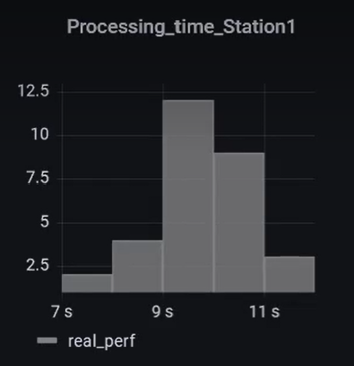
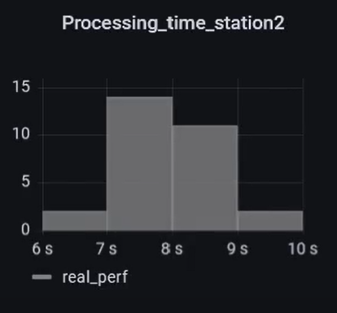
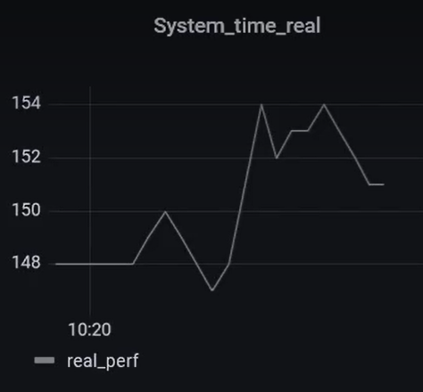
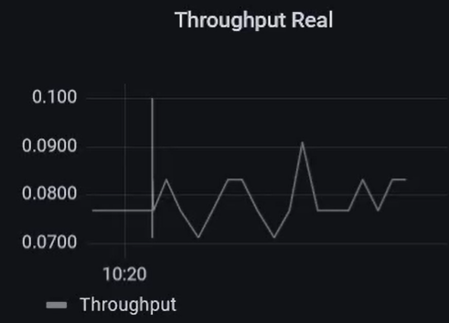
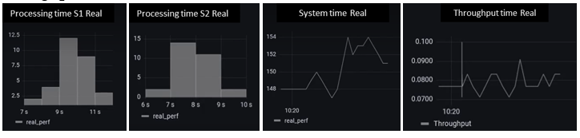
Processing time S1 Real
Processing time S2 Real
System time Real
Throughput time Real
(a)
(b)
(c)
(d)

Slide 6
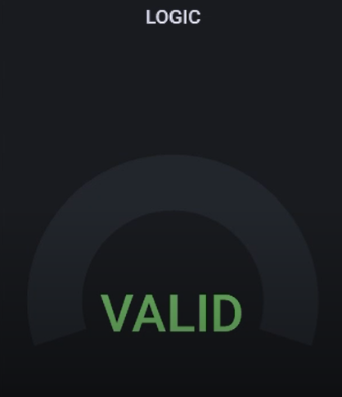
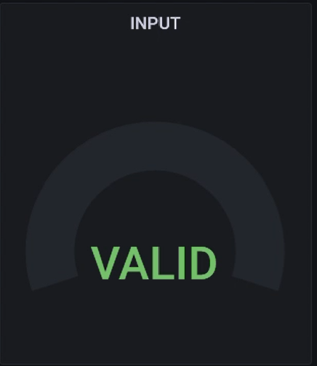
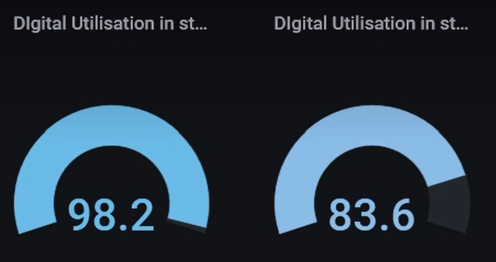
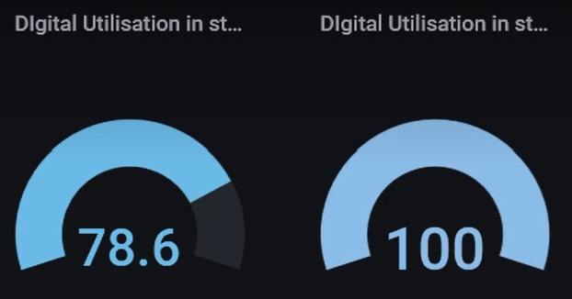
Digital Utilisation S1
Digital Utilisation S2
Logic
Input
(b)
(c)
Digital Utilisation S1
Digital Utilisation S2
Digital Utilisation S1
Digital Utilisation S2
(a)
(b)

Slide 7
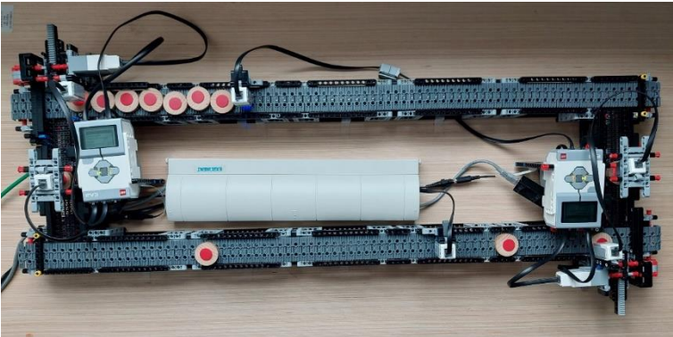
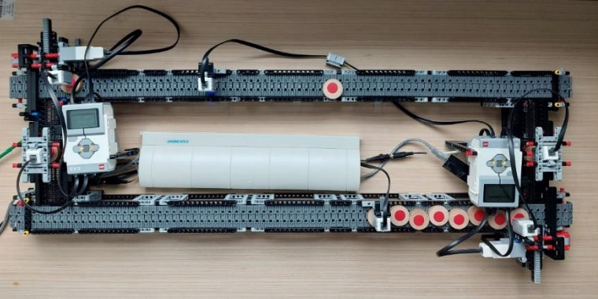
BEFORE EVENT 3
AFTER EVENT 3

Slide 8
